Slide 1
DeepSense: a Unified Deep Learning Model for Time-Series Mobile Sensing Data Processing
Shuochao Yao*, Shaohan Hu^, Yiran Zhao*, Aston Zhang*, Tarek Abdelzaher*
*University of Illinois at Urbana Champaign
^IBM Research
Code available: https://github.com/yscacaca/DeepSense

Slide 2
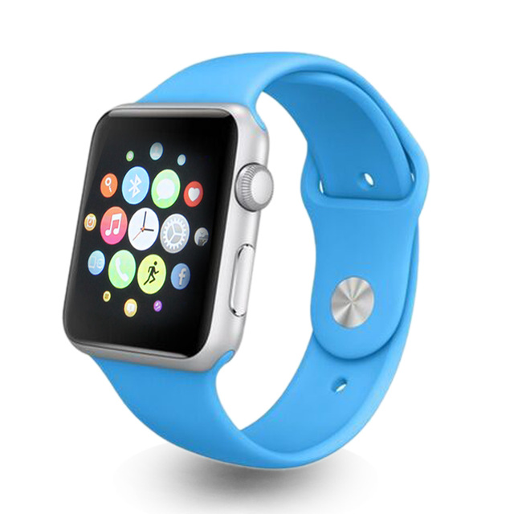
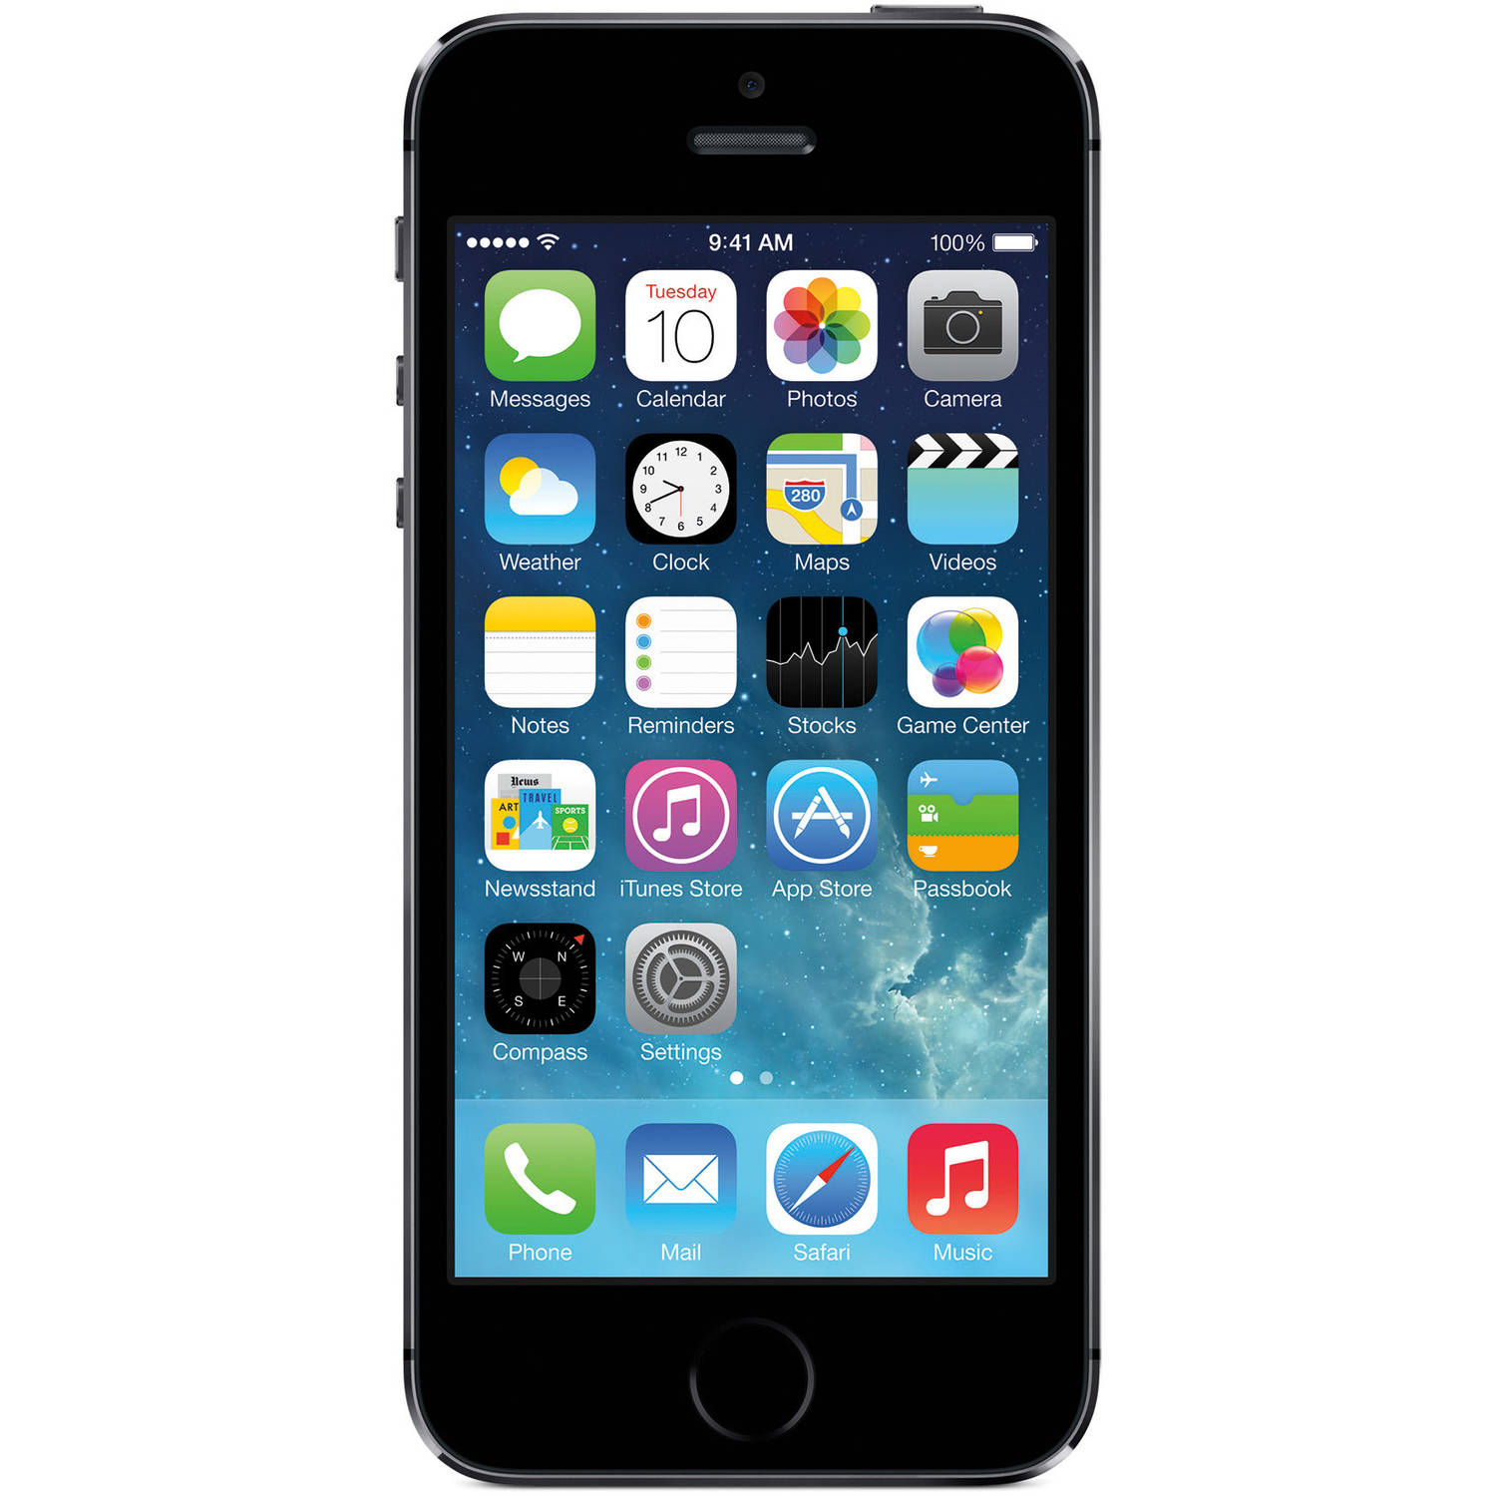
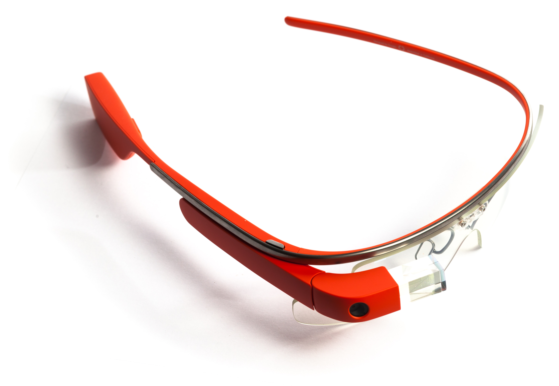
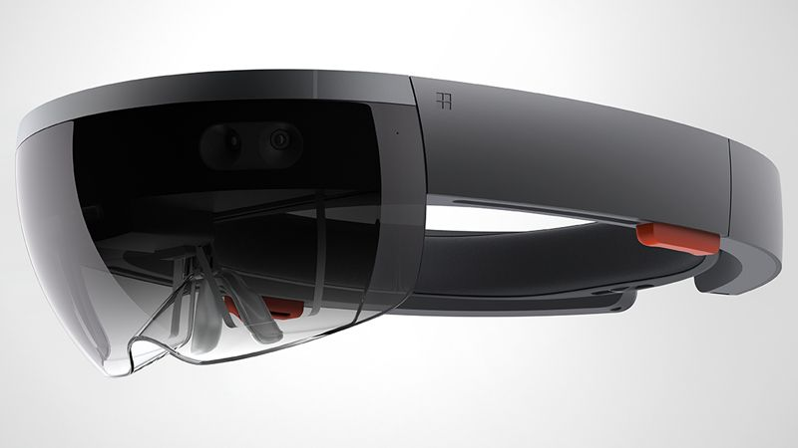
Motivation
Tracking, Localization, Imaging ……
Activities, Surrounding Context, Behavior ……
Sensor Inside !

Slide 3
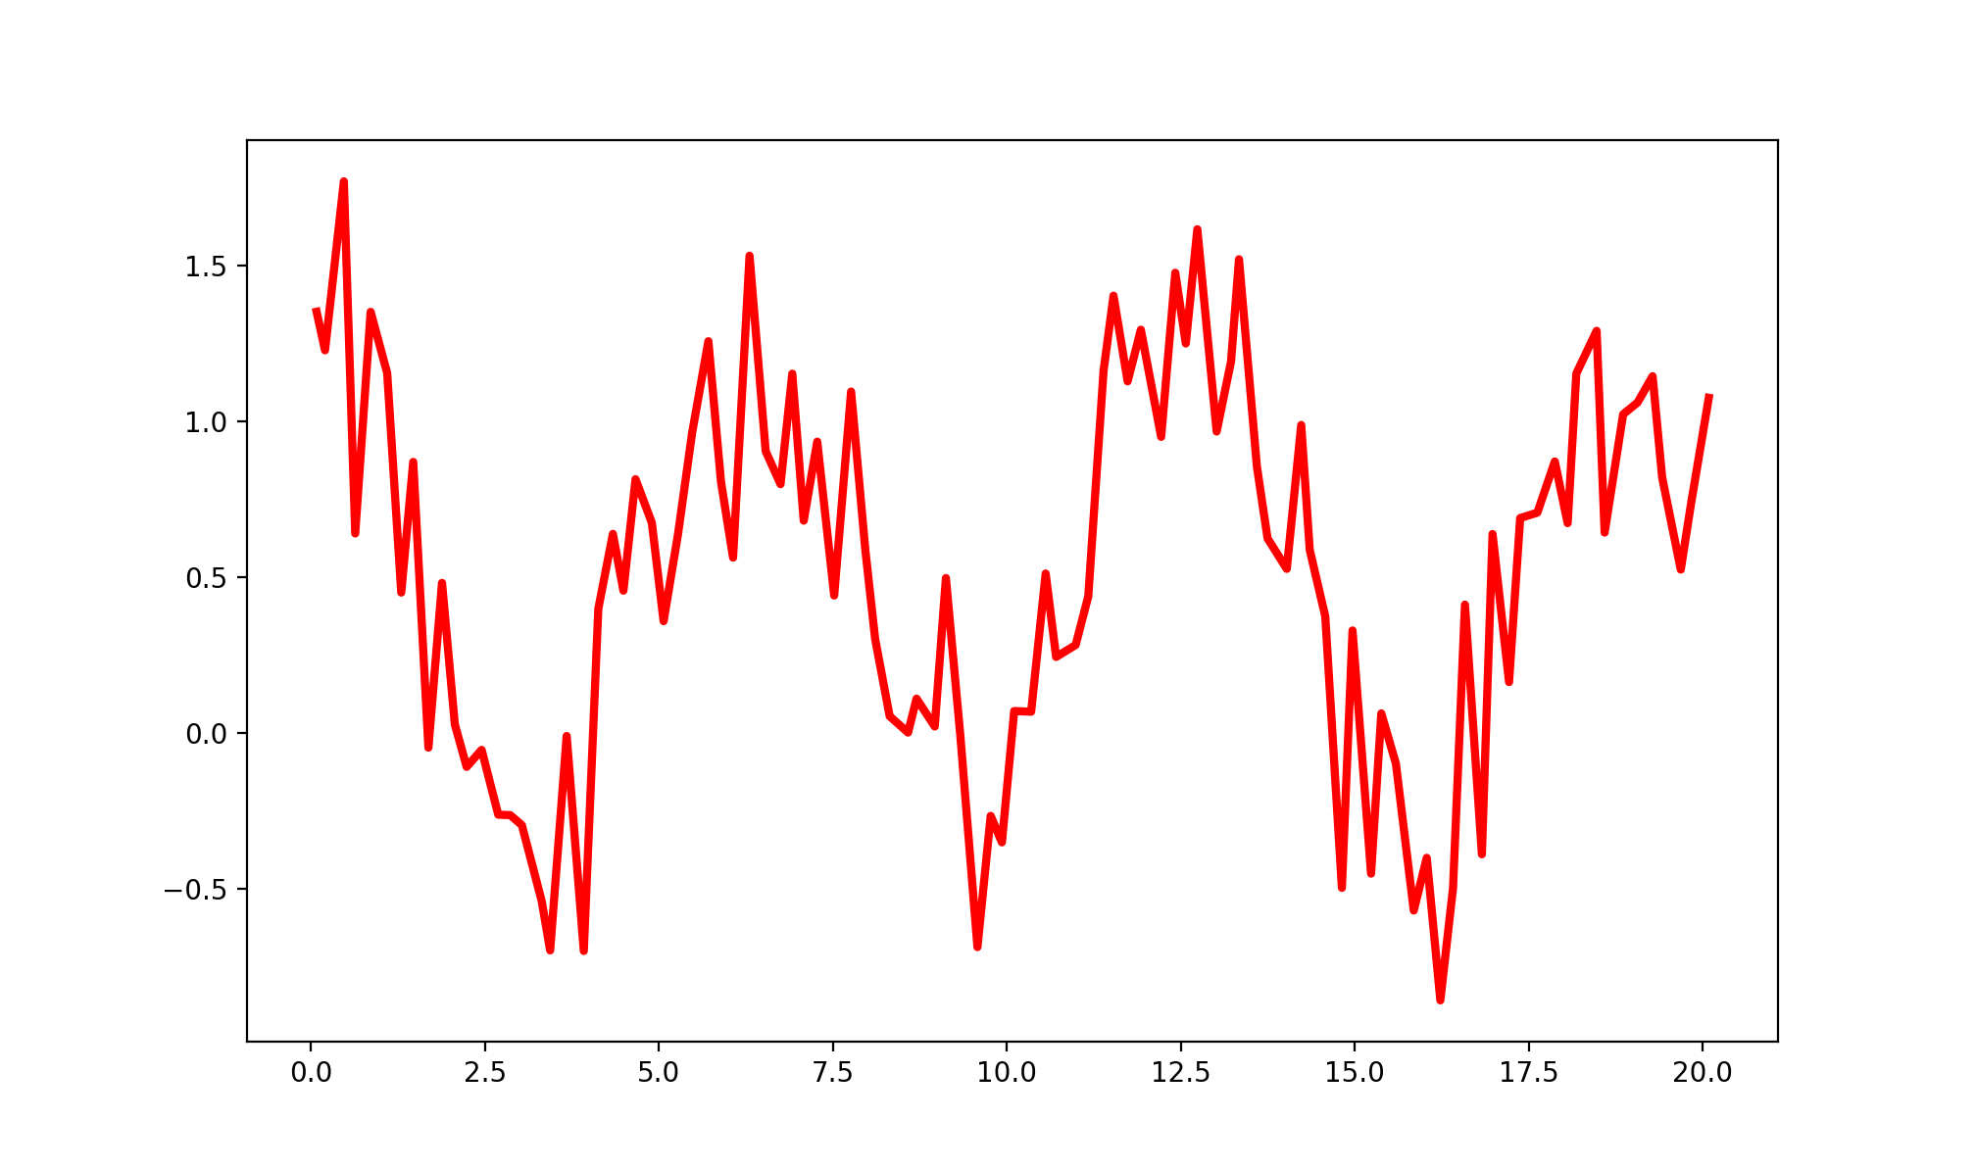
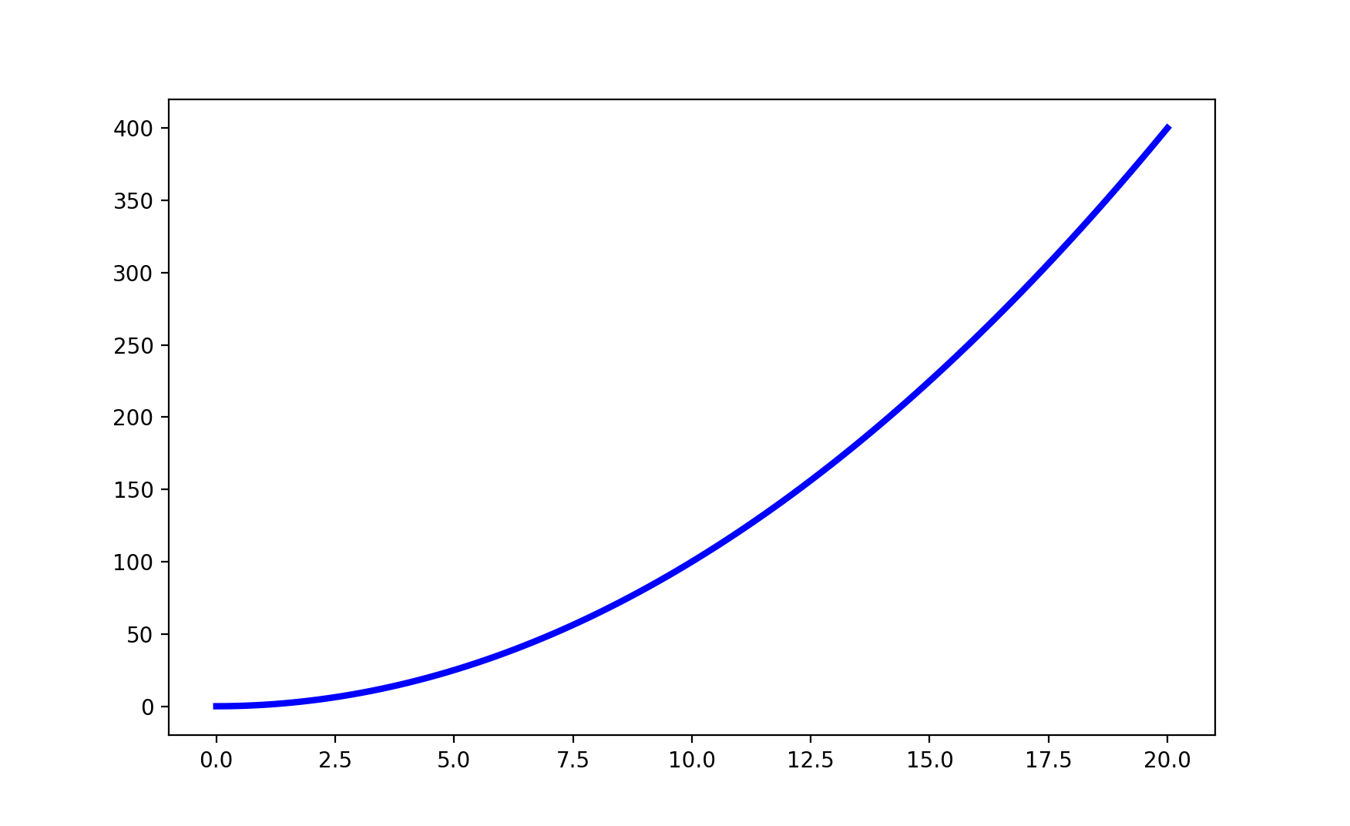
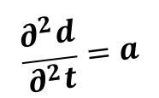
Challenges
Noise Model
Physical Rule
Sensor Input: noisy physical quantity
Out: clean target physical quantity
$$\frac{∂^{2}d}{∂^{2}t}=a$$

Slide 4
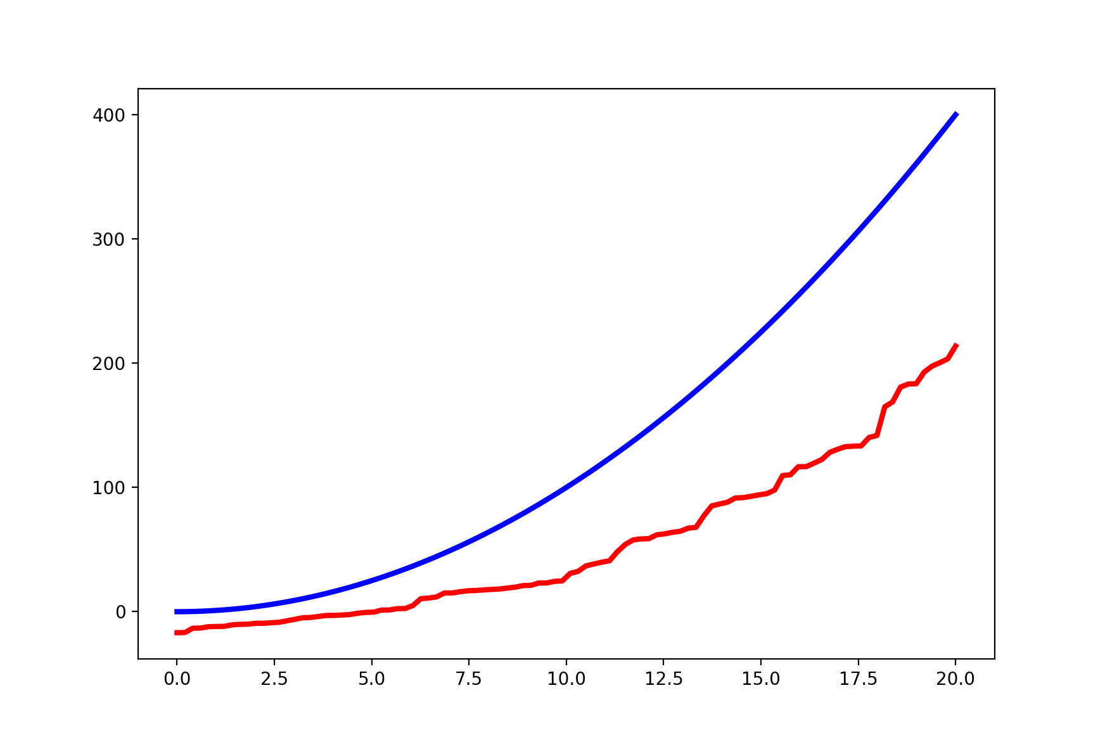
Challenges
Nonlinear
Time-dependent
Noise Model
Physical Rule
Sensor Input: noisy physical quantity
Out: noisy target physical quantity
$$\frac{∂^{2}d}{∂^{2}t}=a$$

Slide 5

Challenges
Hand-crafted features
Classifier
Sensor Input

Slide 6

Challenges
Hand-crafted features
Classifier
Time-consuming
Not Robust
Sensor Input

Slide 7
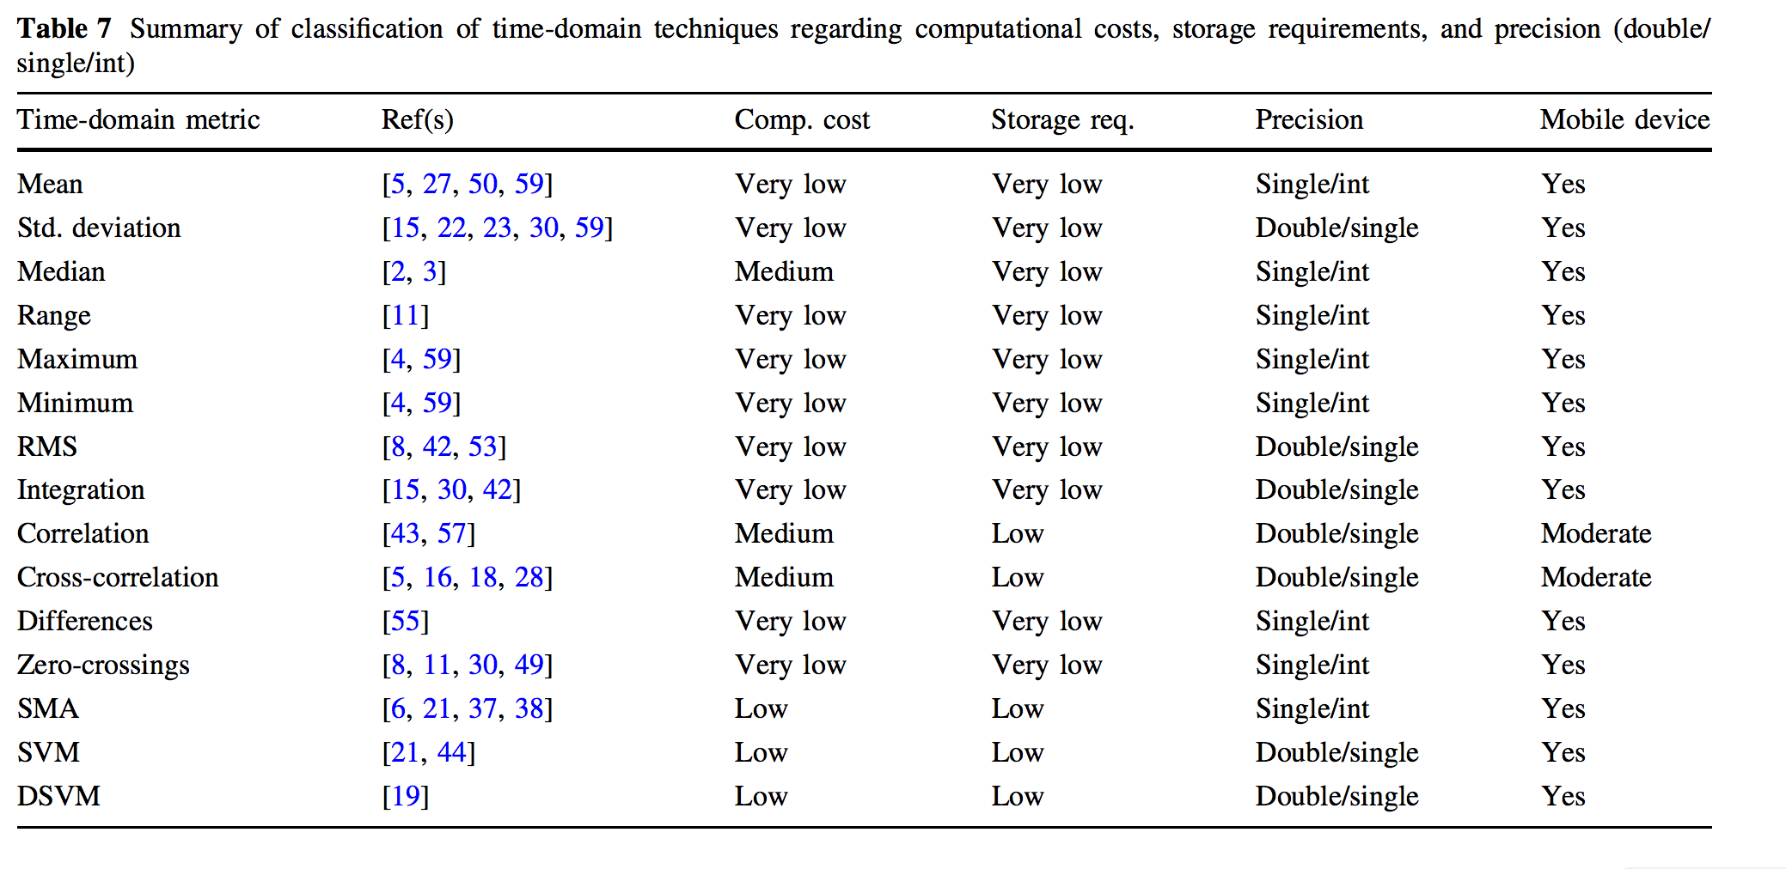
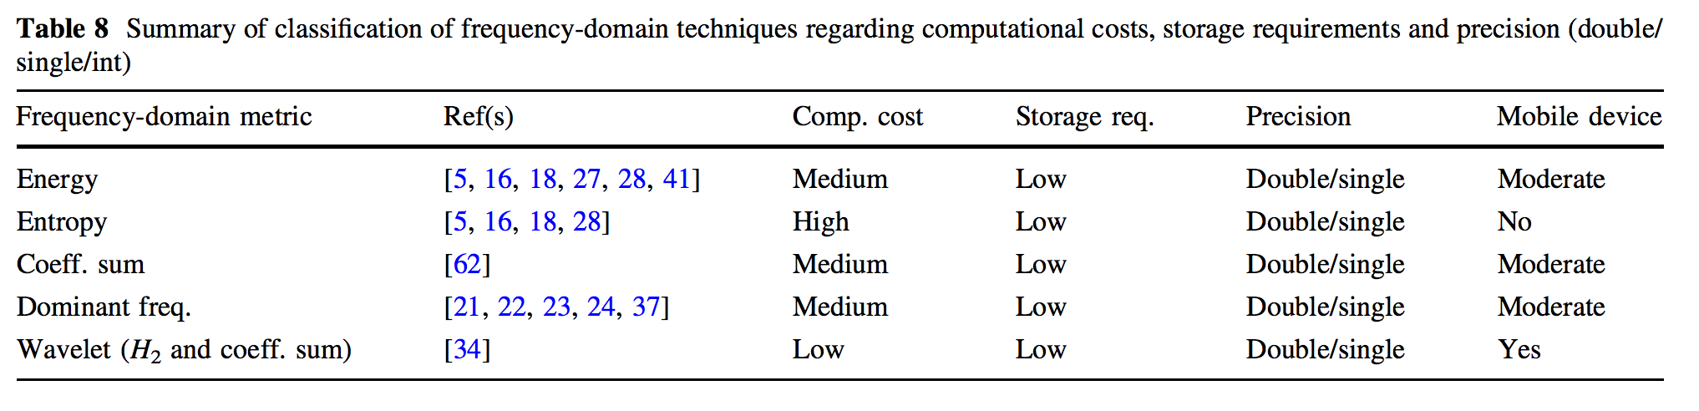
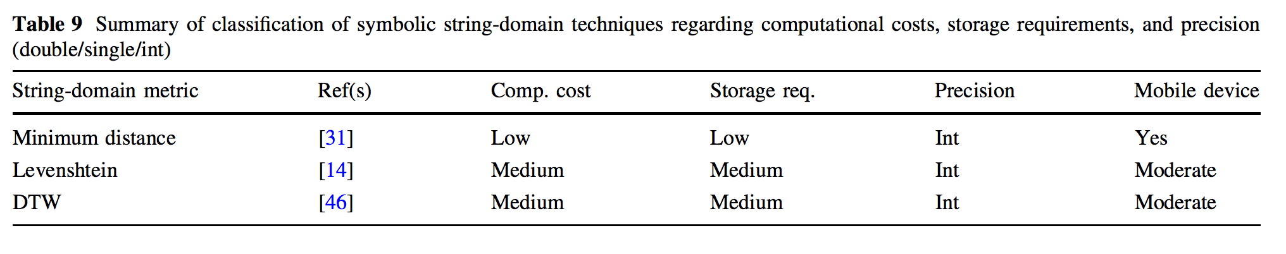
Hand-crafted features

Slide 8
DeepSense: a Unified Model
A deep learning model that models different types of mobile sensing applications in a unified manner.

Slide 9
DeepSense: a Unified Model
A learnable complex nonlinear functions:
composition of physical system and noise model
DeepSense
DeepSense
Sensor Input
An automatic feature extractor
and classifier

Slide 10
DeepSense: Properties
Target physical quantity
Multiple sensor inputs (input physical quantities).
Physical rules involve single quantity.
Physical rules involve multiple quantities.
Physical rules involve time.
Target classes
Multiple sensor inputs.
Local features within each sensor input.
Global features that fuse multiple senor inputs.
Temporal dependencies.
DeepSense
Interactions with single sensor.
Interactions with multiple sensors.
Interactions along time.

Slide 11
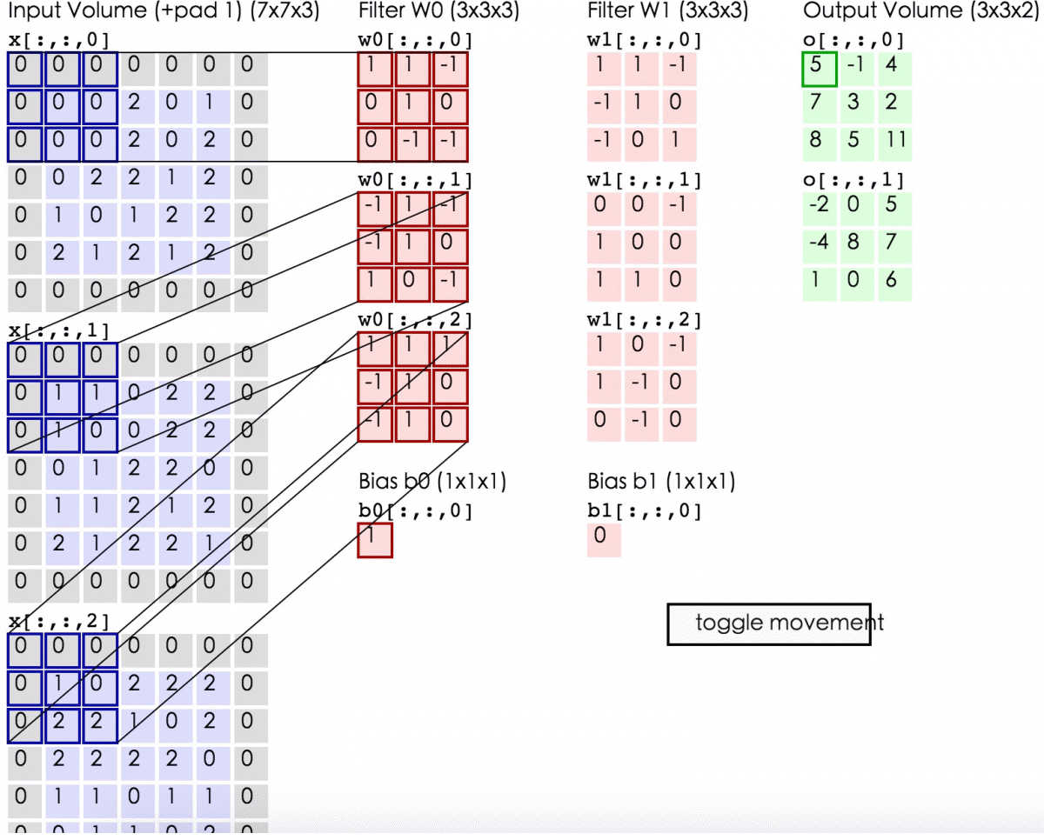
Recap: Convolutional neural network
http://cs231n.github.io/convolutional-networks/

Slide 12

Recap: Recurrent neural network
http://colah.github.io/posts/2015-08-Understanding-LSTMs/

Slide 13
DeepSense: Network Structure
RNN
RNN
RNN
Global Conv
Global Conv
Global Conv
Local
Conv 1
Local
Conv 2
Local
Conv 1
Local
Conv 2
Local
Conv 1
Local
Conv 2
Sensor 1
Sensor 2
Sensor 1
Sensor 2
Sensor 1
Sensor 2

Slide 14
Final Structure

Slide 15
DeepSense: Customization
Most Structure is pre-defined with default values.
For a particular mobile sensing task, you need only to define:
Number of sensor inputs.
Input/output dimension.
Regression/classification.
More customization:
Objective function for training.

Slide 16
Evaluation Tasks
Car tracking with motion sensors (CarTrack)
Regression Based
GPS is unavailable in underground road
Sensing error will be accumulated and there is no additional signal to erase the error
The capability of DeepSense of learning physical rules for noisy sensor data.
Heterogeneous Human activity recognition (HHAR)
Classification Based
State-of-the-art algorithms do not generalize well for a new user who does not appear in the training set
The capability of DeepSense to extract features that generalize well.
User Identification with motion analysis (UserID)
Classification Based
Extend the biometric gait analysis for user identification (walking, biking, stairing up/down, sitting, and standing)
The capability of DeepSense to extract features that differentiate well.

Slide 17
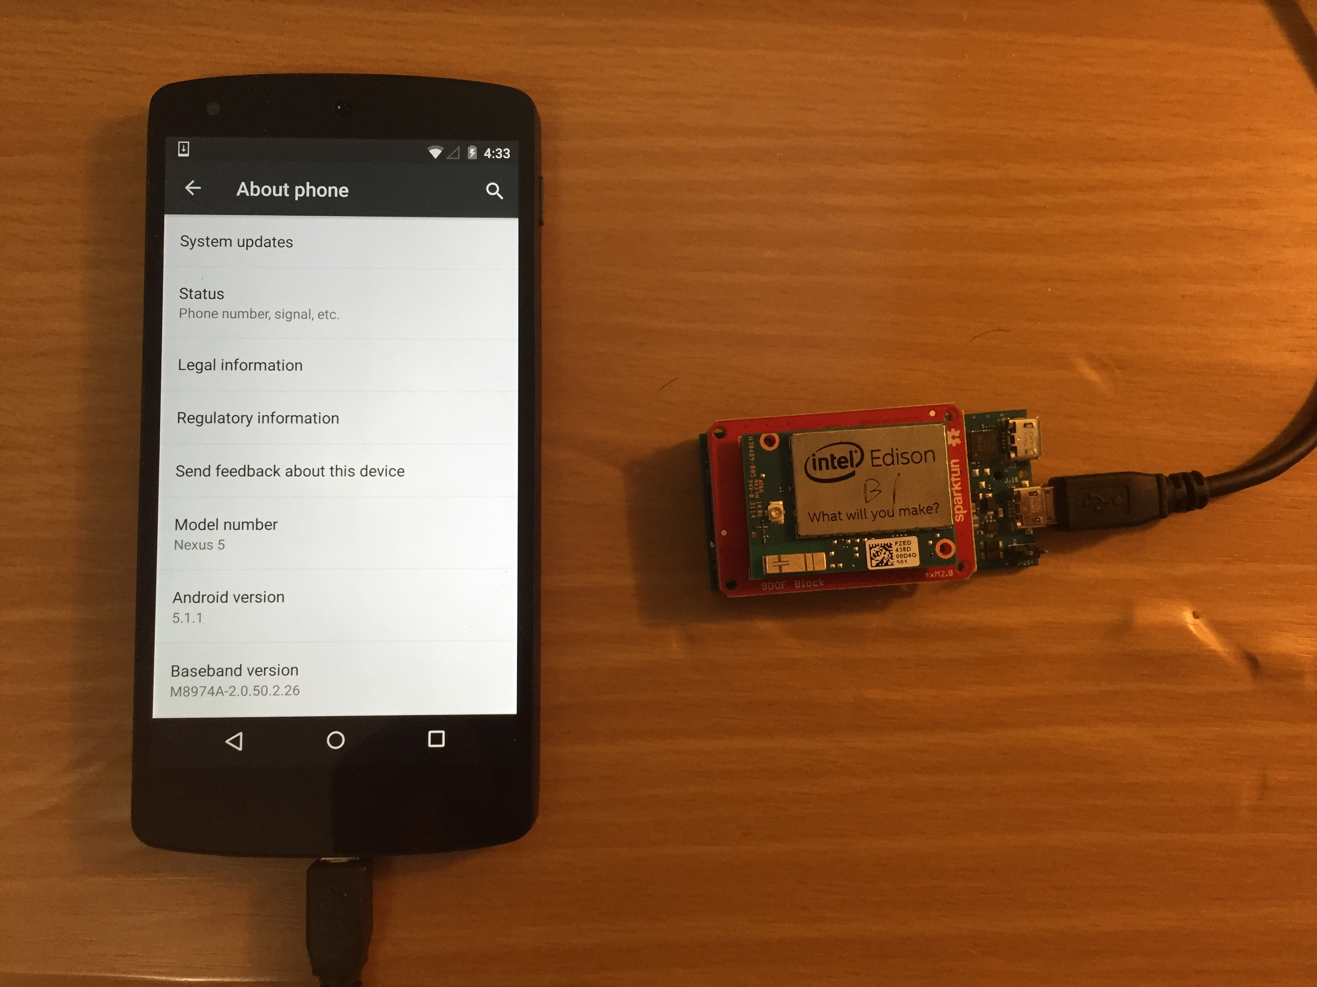
Testing Platform

Slide 18
Algorithm in Comparison (General)
Fit for all three tasks, three variants of DeepSense.
DS-singleGRU:
It replaces the 2-layer stacked GRU with a single-layer GRU with larger dimension, while keeping the number of parameters.
DS-noIndvConv:
There is no individual convolutional layers for each sensor input. Instead, we concatenate the input tensors along the first axis
DS-noMergeConv:
There is no merge convolutional layers at each time interval. Instead, we flatten the output of each individual convolutional layers and concatenate them into a single vector as the input of the recurrent layers.

Slide 19
CarTrack
Specific baseline algorithm
No known feasible solution
eNav (w/o GPS):
Constrains the car movement path according to a digital map
Computes moving distance along the path using double integration of acceleration derived using principal component analysis that removes gravity.
Sensor-fusion algorithm:
Combines gyroscope and accelerometer measurements to obtain the pure acceleration without gravity.
Combines accelerometer, gyroscope, and magnetometer to obtain absolute rotation calibration.

Slide 20
CarTrack

Slide 21
CarTrack: Accuracy
 | MAE (meter) | Map-Aided Track
DeepSense | 40.43 ± 5.24 | 93.8%
DS-SingleGRU | 44.97 ± 5.80 | 90.2%
DS-noIndvConv | 52.15 ± 6.24 | 88.3%
DS-noMergeConv | 53.06 ± 6.59 | 87.5%
Sensor-fusion | 606.59 ± 56.57
eNav (w/o GPS) |  | 6.7%

Slide 22
CarTrack

Slide 23
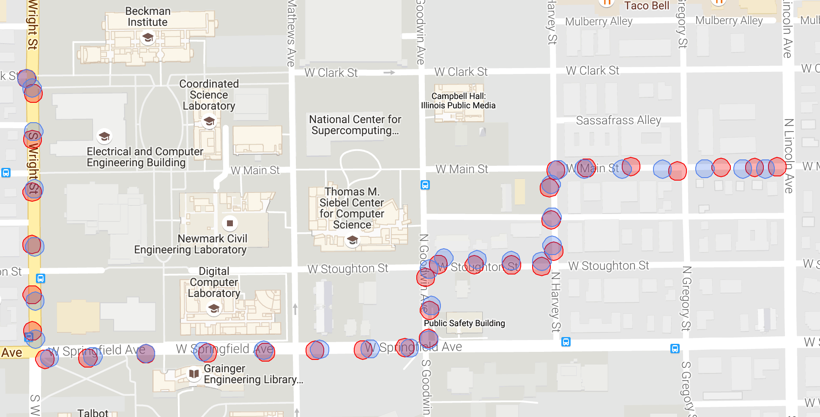
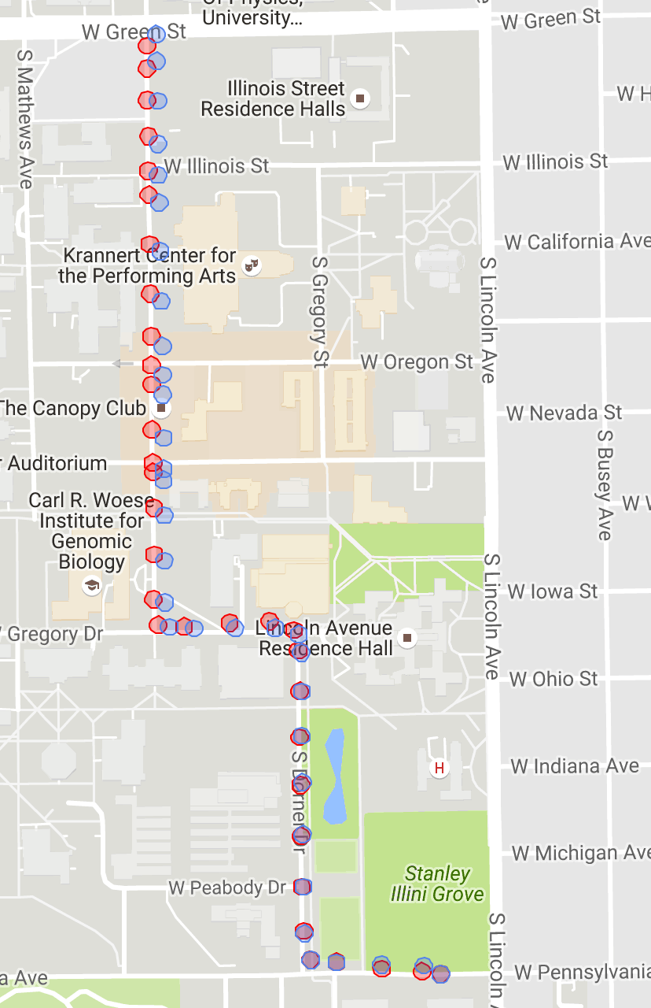
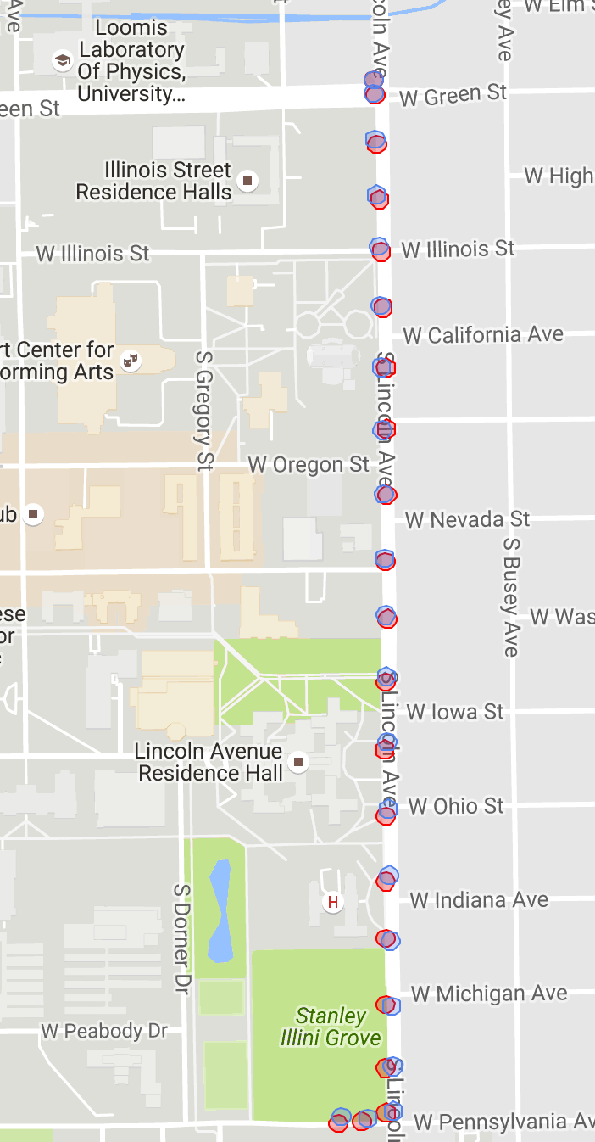
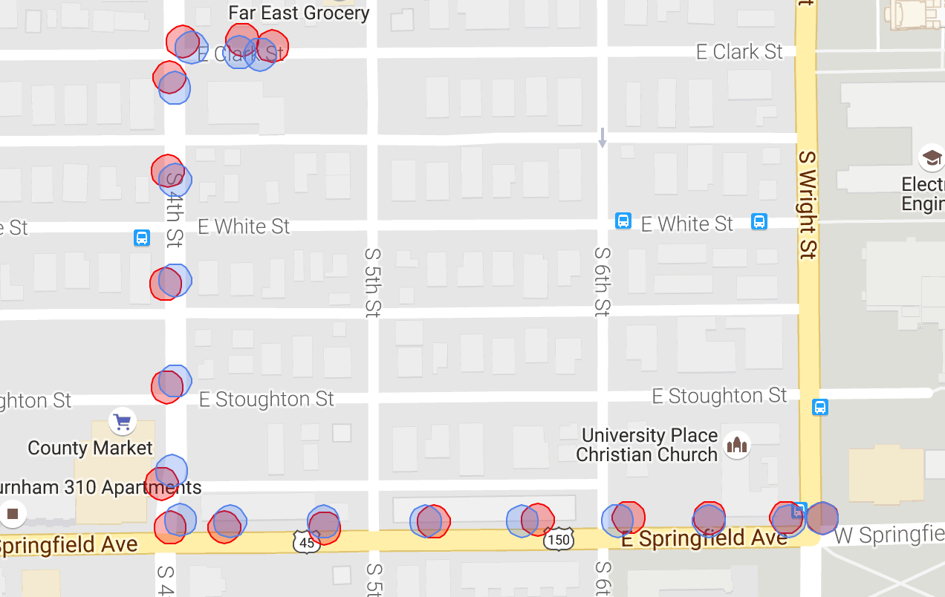
CarTrack: Examples

Slide 24
CarTrack: Running time & Energy

Slide 25
HHAR
Specific baseline algorithms:
HAR-RF:
This algorithm selects all popular time- domain and frequency domain features and ECDF features. Apply random forest as classifier.
HAR-SVM:
Feature selection is same of HAR-RF model. But this model use support vector machine as classifier
HAR-RBM:
This is model based on stacked restricted boltzmann machines with frequency domain representations as inputs.
HAR-MultiRBM:
Apply a dependent HAR-RBM to each sensor input, and fuse output with another HAR-MultiRBM

Slide 26
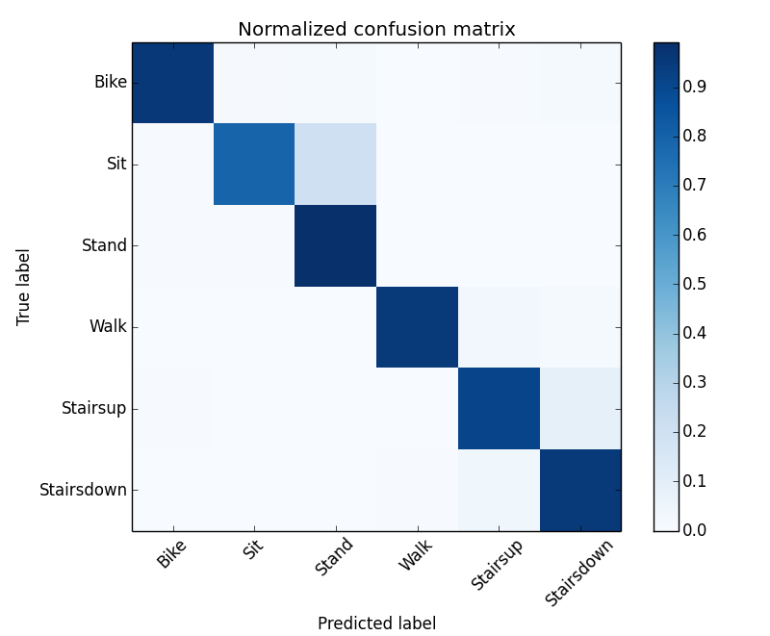
HHAR: Accuracy

Slide 27
HHAR: Running time & Energy

Slide 28
UserID
Specific baseline algorithms:
GaitID:
This model extracts the gait template and identifies user through template matching with support vector machine.
IDNet:
This model first extracts the gait template, and extract template features with convolutional neural networks. Then this model identifies user through support vector machine and integrates multiple verifications with Wald’s probability ratio test.

Slide 29
UserID: Accuracy

Slide 30
UserID: Running time & Energy

Slide 31
Thanks
Code available: https://github.com/yscacaca/DeepSense

Slide 32
Following Works
FastDeepIoT: Towards Understanding and Optimizing Neural Network Execution Time on Mobile and Embedded Devices -- ACM SenSys, 2018.
SenseGAN: Enabling Deep Learning for Internet of Things with a Semi-Supervised Framework--IMWUT, 2018.
Towards Environment Independent Device Free Human Activity Recognition -- MobiCom, 2018.
Deep Learning for the Internet of Things -- Computer Magazine, 2018.
ApDeepSense: Deep Learning Uncertainty Estimation Without the Pain for IoT Applications --ICDCS, 2018.
DeepIoT: Compressing Deep Neural Network Structures for Sensing Systems with a Compressor-Critic Framework (Best Paper Award Nominee)-- ACM SenSys, 2017.
RDeepSense: Reliable Deep Mobile Computing Models with Uncertainty Estimations -- IMWUT, 2017.

Slide 33
Deep Learning for IOT and Big Data Streaming Analytics A SURVEY
Presenters: Mei Wang
Notes:
Let’s start
I am

